Slide 1
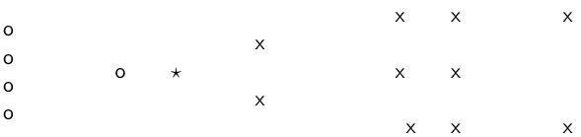
Question 1
Class 1 = Circle , Class 2 = Cross
How is star classified by:
(i) 1-NN (ii) 3-NN (iii) 9-NN (iv) 15-NN (v) Rocchio?
1

Slide 2
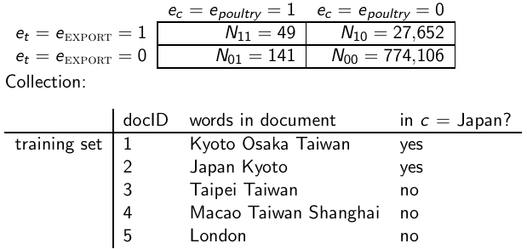
Question 2
(i) Compute the “export”/POULTRY contingency table for the
“Kyoto”/JAPAN in the collection given below.
(ii) Make up a contingency table for which MI is 0 – that is, term and class are independent of each other.
2

Slide 3
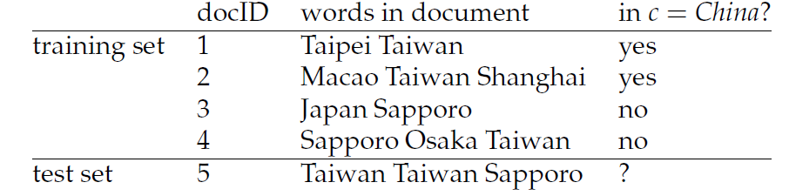
Question 3
Based on the data in Table
estimate a multinomial Naive Bayes classifier,
(ii) apply the classifier to the test document,
(iii) estimate a Bernoulli NB classifier,
(iv) apply the classifier to the test document.

